Slide 1
Modeling Pyroclastic Density Currents
Pyroclastic density currents (PDCs) are among the most deadly volcanic phenomena.
Mitigation of risk associated with PDCs depends upon accurate forecasting of possible inundation areas, often using mobility metrics, the distribution of past deposits, or flow models.

Slide 2

What are PDCs?

Slide 3
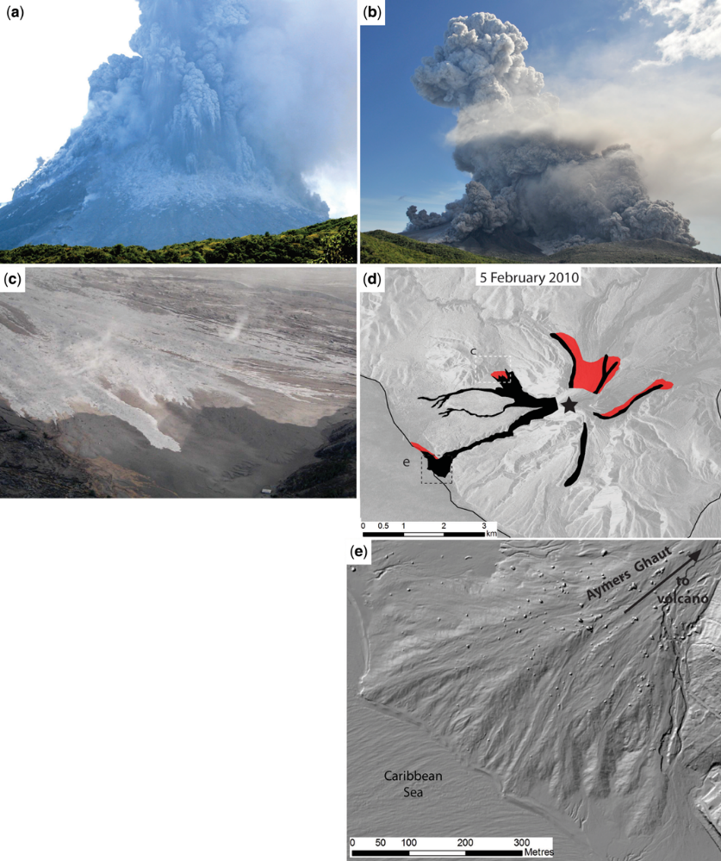
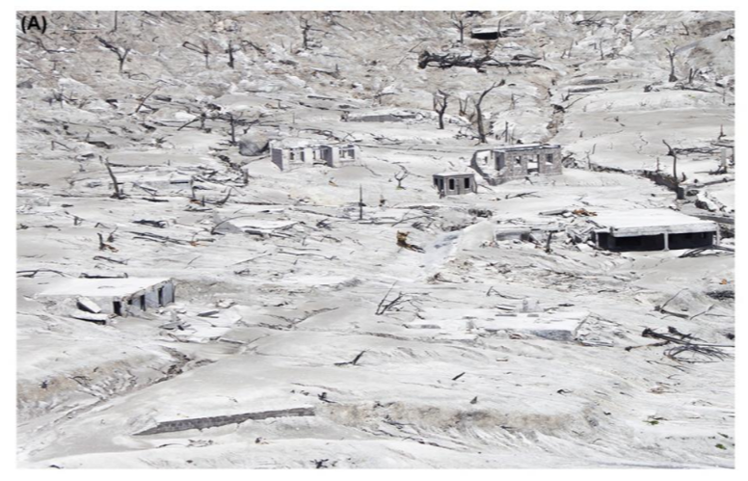
Pyroclastic Density Currents (PDCs)
Fast-moving, hot, ground-hugging mixtures of gas and particles (up to v. large blocks)
Extremely destructive and cause lots of deaths
Includes pyroclastic flows, surges, blasts, ash flows, nuée ardentes, block-and-ash flows, pumice flows, etc. Often, the deposits have different names than the flows (a wide range of names are used interchangeably and confusingly). PDC is a catch all term that I’ll use.

Slide 4
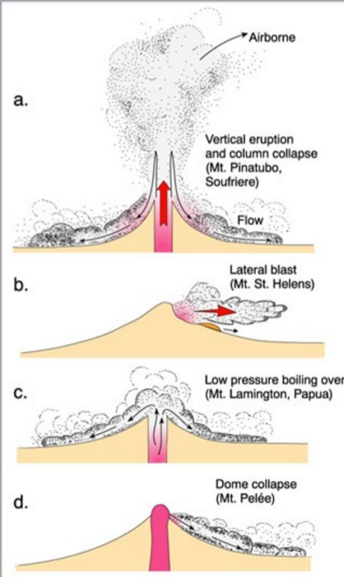
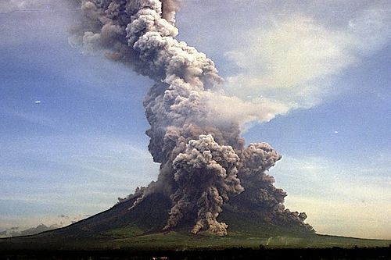
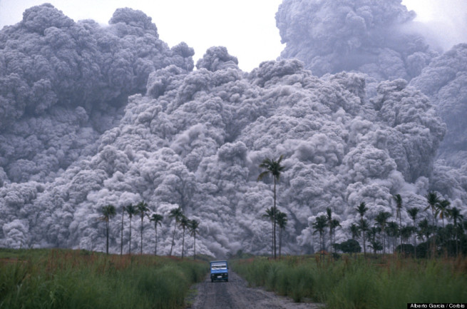
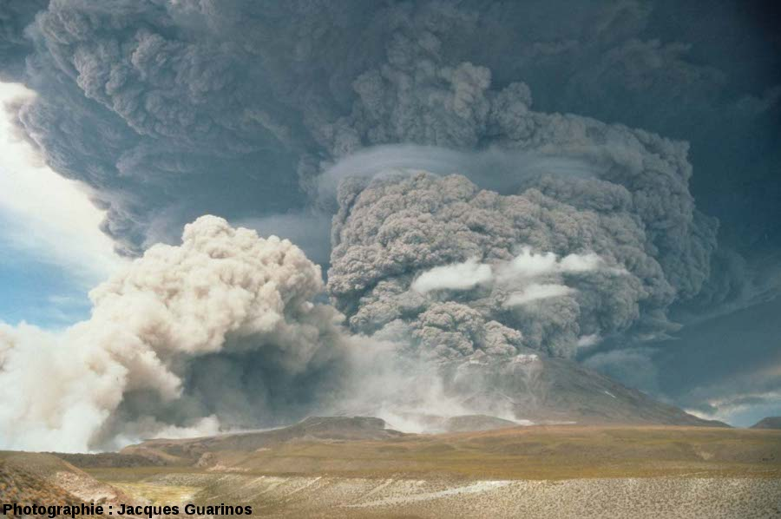
Column-collapse PDCs are formed by the collapse of a vertical explosive column that falls back to earth and continues to travel along the ground. They form pumice and ash rich ignimbrite or pumice-flow deposits, that are radially distributed around the volcano.
Mayon, Philippines
Lascar, Chile
Pinatubo, Philippines

Slide 5
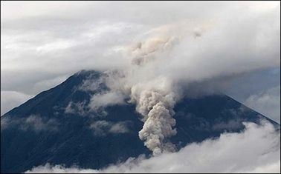
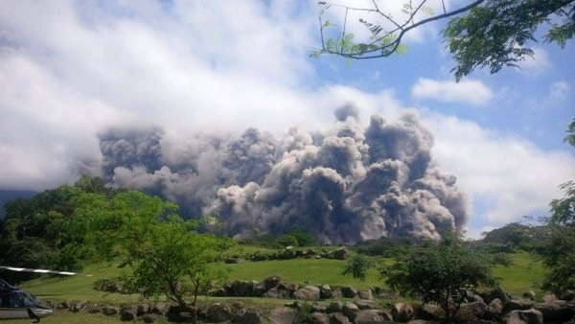
Sometimes, pressures are not great enough to form a full vertical column and result in “boiling-over” style activity, which produces PDCs similar to those from column-collapses.
Fuego, Guatemala
Tungurahua, Ecuador

Slide 6
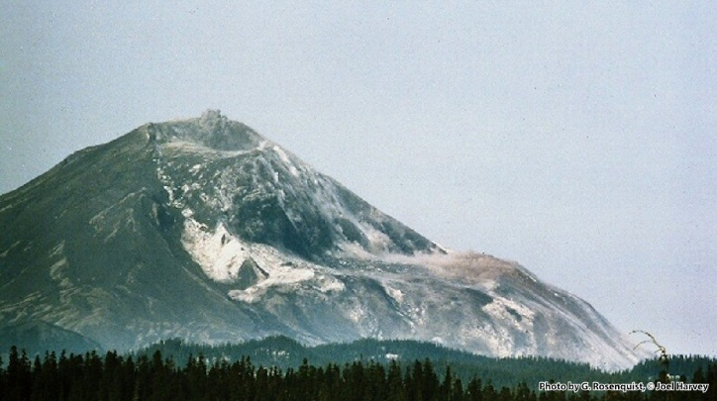
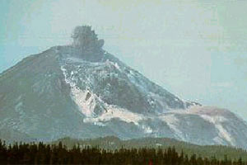
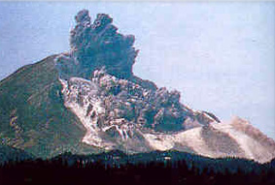
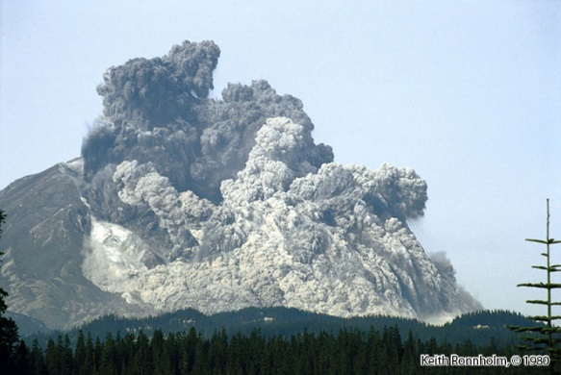
Instead of being directed vertically, blasts can be directed horizontally and form strongly erosive lateral blast PDCs.

Slide 7
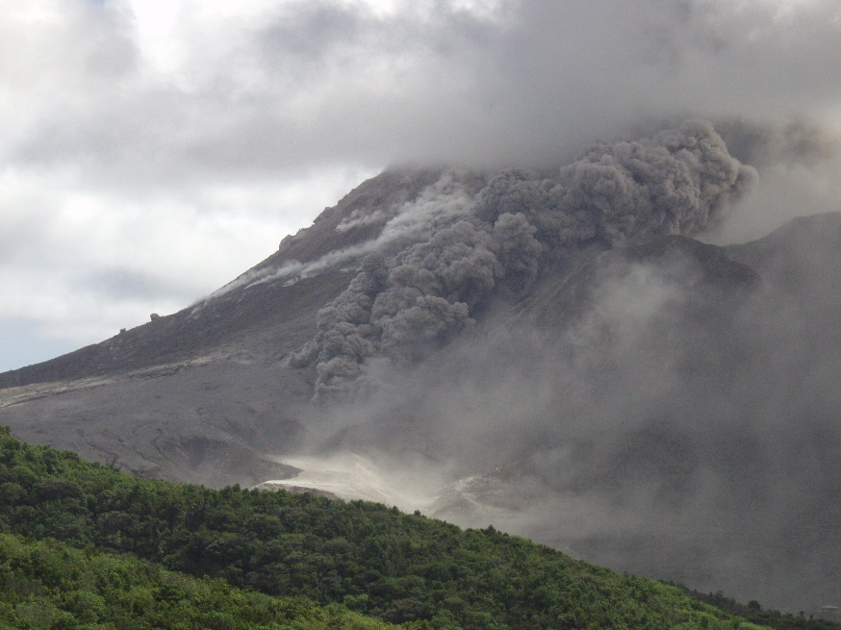
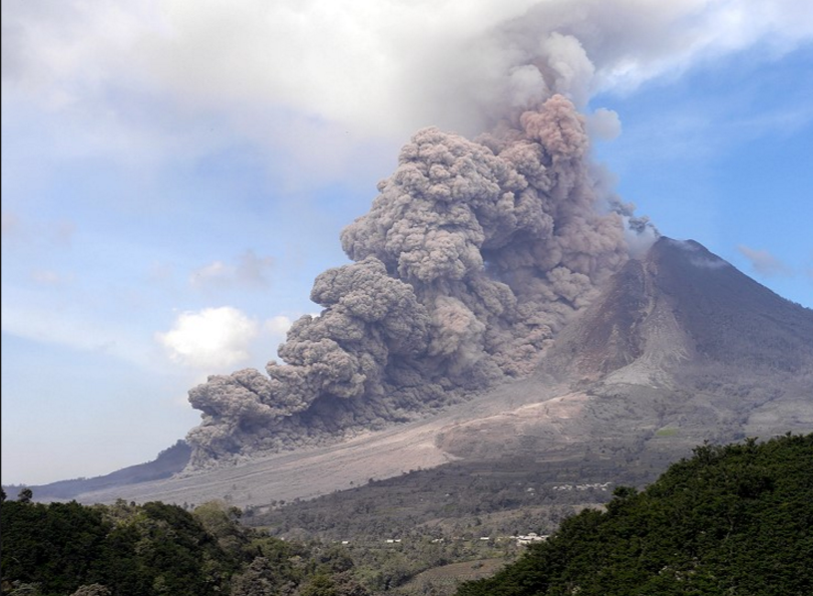
Soufrière Hills Volcano, Montserrat
Sinabung, Indonesia
High-particle concentration PDCs are generated by the gravitational or explosive collapse of lava domes. These flows form block-and-ash flow deposits.
Sometimes see “Pelée type” (explosive dome-collapse) or “Merapi type” (gravitational dome-collapse)

Slide 8
How do we model PDCs?

Slide 9
Parts of a PDC
Buoyantly lofting
phoenix cloud or co-ignimbrite cloud
Lava dome
Dilute, over-riding
ash-cloud surge
PDCs are understood to be density-stratified currents which, to varying degrees, develop high concentration, dense undercurrents (dense basal avalanches) and dilute, turbulent, overriding ash clouds (ash-cloud surges).
Dense basal avalanche

Slide 10
Parts of a PDC
Buoyantly lofting
phoenix cloud or co-ignimbrite cloud
Lava dome
Dilute, over-riding
ash-cloud surge
Dense basal avalanche usually follows along valleys (but sometimes escapes)
Ash-cloud surge often spread outside of channels, and sometimes can detach from the dense basal part and go in a different direction
Dense basal avalanche

Slide 11
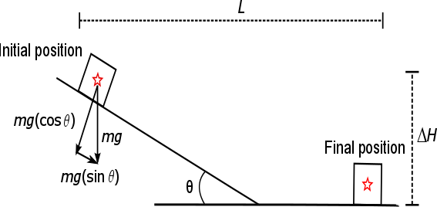
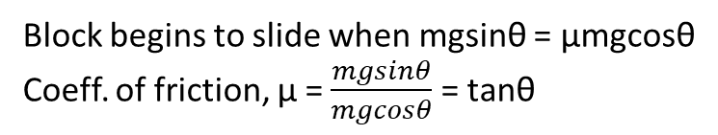
∆H/L or
Heim coefficient
Height dropped/runout length
Block begins to slide when gravitational force down a plane equals the frictional force
Tanθ =coeff. of friction, μ = ΔH/L = Heim coefficient
Block begins to slide when mgsinθ = μmgcosθ
Coeff. of friction, μ = $\frac{mgsinθ}{mgcosθ}$ = tanθ

Slide 12
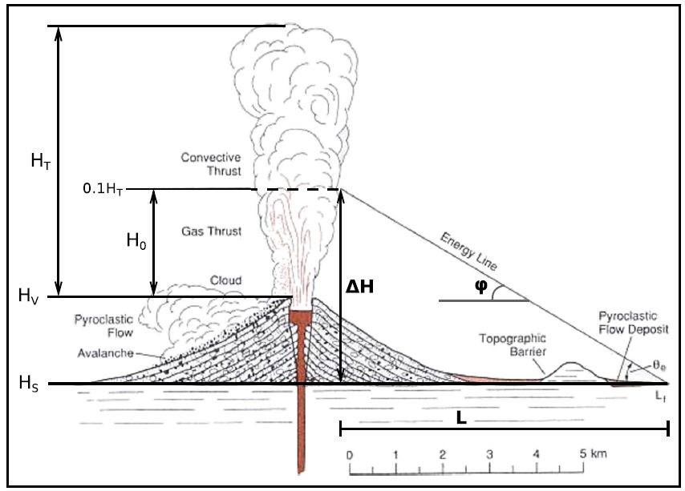
∆H/L or
Heim coefficient
For column-collapse flows, the H doesn’t start at the top of the dome, it starts from where the collapse happens, at the top of the ‘gas thrust’ region
Column-collapse PDCs usually collapse 500-2000 m above the summit
Block begins to slide when mgsinθ = μmgcosθ
Coeff. of friction, μ = $\frac{mgsinθ}{mgcosθ}$ = tanθ

Slide 13
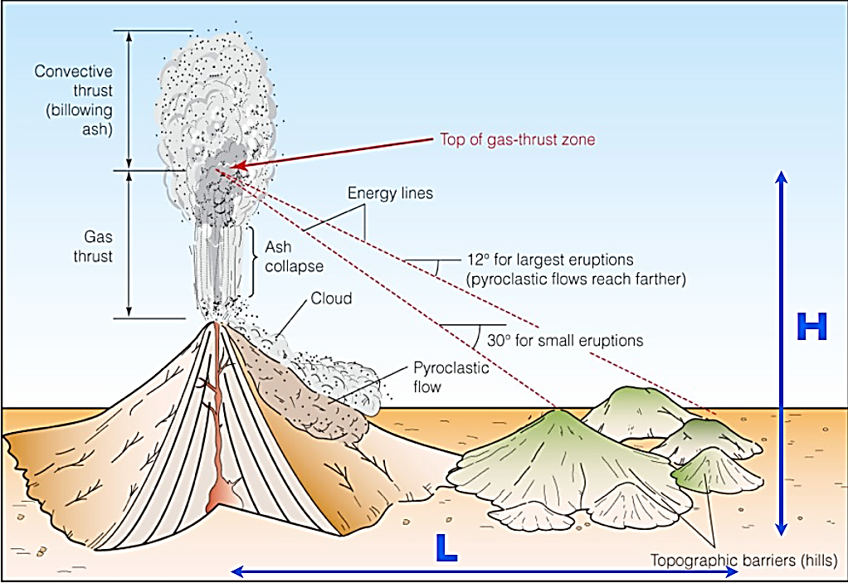
∆H/L or
Heim coefficient
For column-collapse flows, the H doesn’t start at the top of the dome, it starts from where the collapse happens, at the top of the ‘gas thrust’ region
Column-collapse PDCs usually collapse 500-2000 m above the summit

Slide 14
∆H/L or
Heim coefficient
∆H/L vs PDC Volume
Should be independent of mass/volume, and depend on material propertied but actually ΔH/L shows an inverse relationship with volume
Large volume flows are more mobile than small volume flows
Lots of different theories to explain this ‘excess mobility’. Large volume flows have complex rheologies that are difficult to simplify in any model.
Lots of scatter in the data
More mobile
Best fit: ∆H/L = 0.10(Volume^{-0.15})

Slide 15
∆H/L or
Heim coefficient
Global data
SHV data only
Best-fit regression
95% Confidence Interval
95% Prediction Interval
Different volcanoes can have differences in mobility
For example, PDCs at SHV in Montserrat are more mobile than elsewhere, probably because of channelization and other topographic effects
More mobile

Slide 16
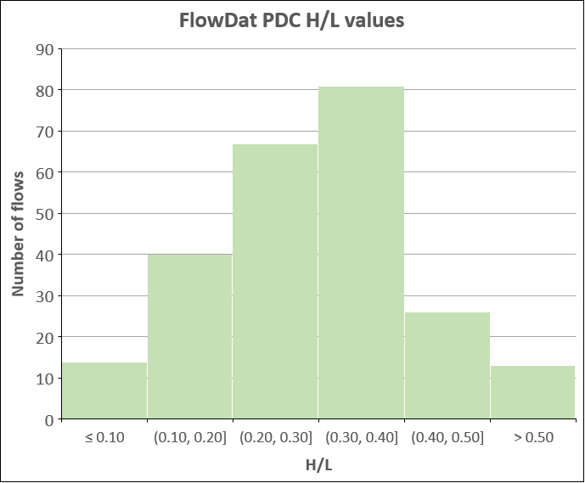
# | 241 (with H/L values)
Avg. | 0.30
Median | 0.30
Min. | 0.04 (very large ignimbrites)
Max. | 0.80 (very small dome-collapses/rockfalls)
Middle 80% | 0.15-0.44
Most PDCs: 0.2-0.4

Slide 17
∆H/L ranges for dome- and column-collapse PDC energy cones from FlowDat regressions
Volume (km³) | Volume (10⁶ x m³) | ∆H/L best fit Dome collapse | ∆H/L best fit Column collapse
0.0001 | 0.1 | 0.39 | 0.46
0.001 | 1 | 0.28 | 0.43
0.01 | 10 | 0.21 | 0.27
0.1 | 100 | 0.15 | 0.17
Dome-collapse PDCs (based on 123 flows): ∆H/L = $0.108\left(V^{−0.140}\right)$
Column-collapse PDCs (based on 16 flows): ∆H/L = $0.106\left(V^{−0.201}\right)$
All PDCs (based on 156 flows): ∆H/L = $0.108\left(V^{−0.141}\right)$

Slide 18
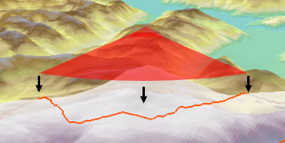
Energy Cone
Also called ∆H/L cone
One of the first modeling techniques applied to PDCs
Uses the ∆H/L vs. volume relationship to draw a line from the summit of the volcano to the estimated extent of PDCs using the ∆H/L ratio
Can be done by hand on a map, or using a GIS program
Used many places, often in combination with other modeling techniques

Slide 19
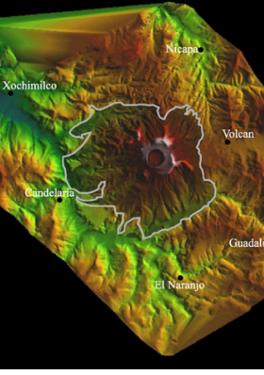
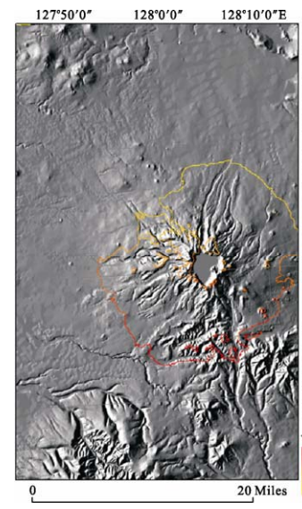
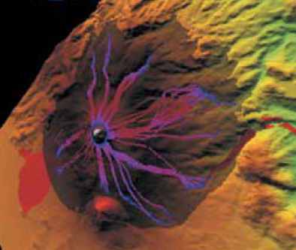
Energy Cone
Also called ∆H/L cone
One of the first modeling techniques applied to PDCs
Uses the ∆H/L vs. volume relationship to draw a line from the summit of the volcano to the estimated extent of PDCs using the ∆H/L ratio
Can be done by hand on a map, or using a GIS program
Used many places, often in combination with other modeling techniques
Energy cone at El Chichón, Mexico
Macías et al. 2008
Energy cone at Tianchi volcano, China
Wan et al. 2012
Energy cone & FLOW2D at Citlaltépetl, Mexico
Sheridan & Macias, 2004

Slide 20
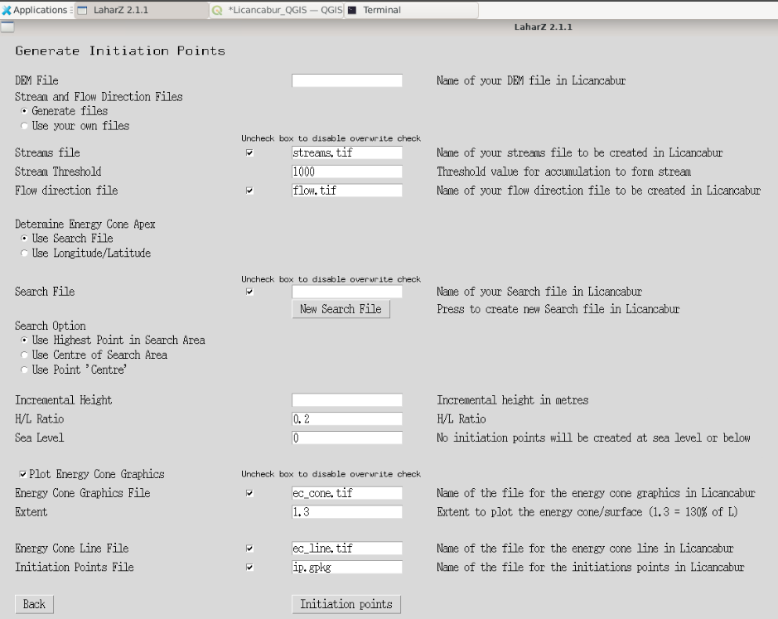
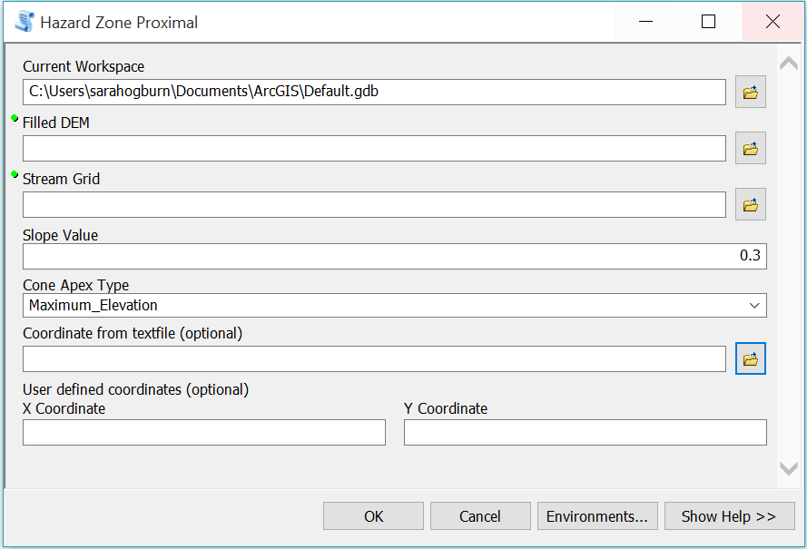

Slide 21
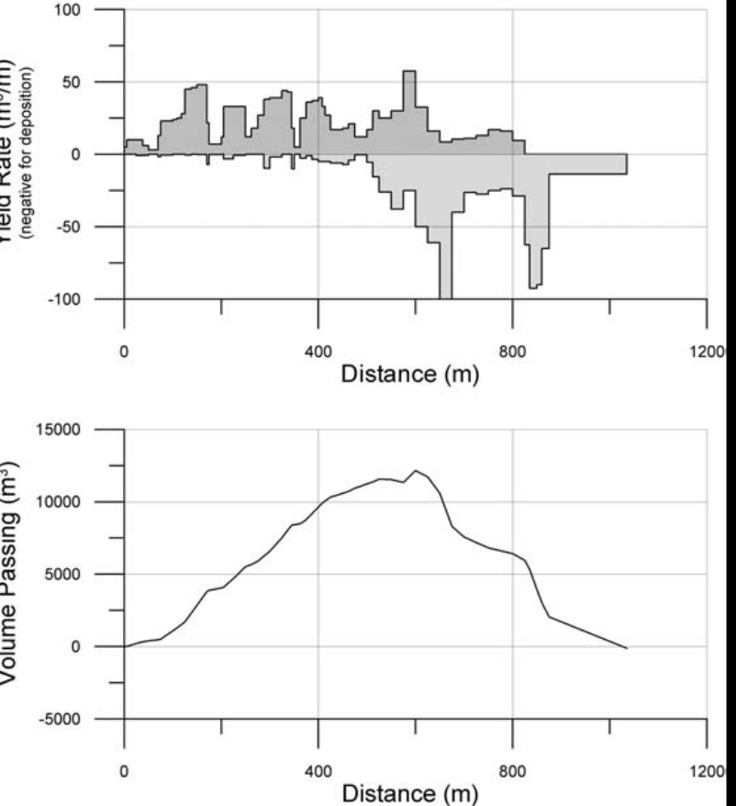
Proximal Hazard Zone for LAHARZ
Why use H/L Cone for lahars?
Lahars may initiate anywhere on the volcano edifice. We can’t know an exact start location in advance.
Loose pyroclastic flow deposits and ashfall are often the source material for lahars and are most abundant within the H/L cone.
Lahars gain volume (entrain material) on steep slopes.
Lahar Mass Balance Analysis
Volume peaks and declines
Volume
net erosion
net deposition
So, we start modeling lahars by estimating where on the flanks the flow volume is greatest.
We do this by defining an H/L cone that marks the transition between erosion and deposition. That is, inside the H/L cone, the volume is still increasing. Outside the H/L cone, the volume is maintained or decreasing (depositing).
How do we identify an H/L cone that represents this transition?
  from net erosion to net deposition
  from steep slopes to moderate slopes (20°-30°), that is, find the break in slope
  from pyroclastic debris fans to more channelized flows

Slide 22
∆H/L cone for LAHARZ proximal hazard zone
Energy cone (or ∆H/L cone) for PDCs
Trying to find the ∆H/L cone where erosion ends and deposition begins (break in slope) in order to start the LAHARZ model
Has to do with the shape of the volcano, where most PDCs inundate, where the slopes are steepest
Depending on what value you choose, includes most average size PDCs and other proximal hazards
For many volcanoes, this is enough
Trying to find/predict the runout of PDCs of varying sizes
∆H/L value used has to do with the volume of the PDC
Lower values for larger PDCs (0.1-0.2) and higher values for smaller PDCs (0.2-0.5)
Important if you want to show energy cones for different size PDCs
For volcanoes with large PDCs, or populations that live very close to the volcano, it might be useful to have more than the 1 proximal hazard zone, and instead add another 1-2 energy cones representing larger (or smaller) volume PDCs
Volume peaks and declines
Volume
net erosion
net deposition

Slide 23
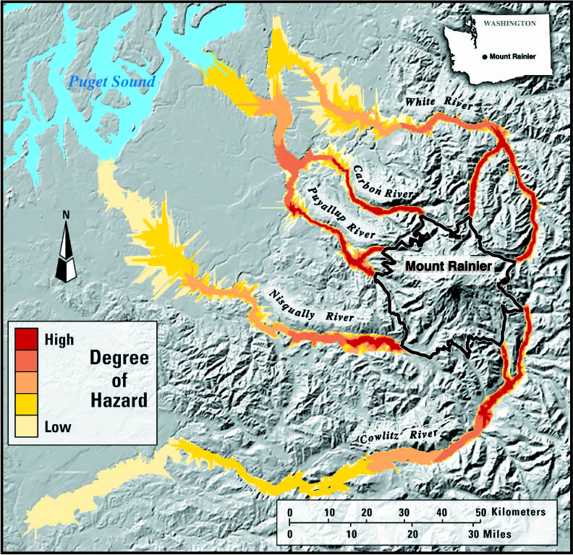
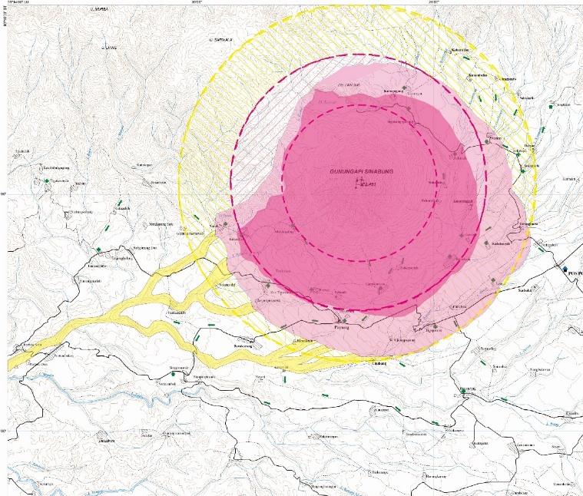
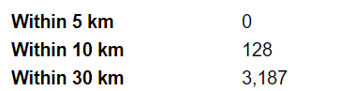
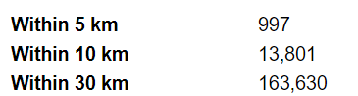

Slide 24
Possible Lahar and PDC Modeling Workflow
For volcanoes with moderate PDCs/low population density:
1. Run LAHARZ using an H/L cone that identifies where lahars will switch from deposition to erosion. This is sort of like identifying where the break in slope is at your volcano. It is usually between 0.1-0.3 and will depend a bit on the size of the volcano. Use the starting points it finds to run LAHARZ for your desired range of lahar volumes (you can always edit the starting point list down to one point per stream, it usually identifies too many points). Display this H/L cone on the map and call it the 'proximal hazard zone' for PDCs and ballistics. Done!
For volcanoes with large PDCs, or high population densities near the volcano:
2. Create more PDC hazard zones instead of just one proximal hazard zone. Use the H/L cone from step 1 to run LAHARZ. Choose some PDC volumes, maybe 0.001, 0.01, 0.1 km³ (depends on your volcano). Using these volumes, use the regression equations to find what an appropriate H/L value is for these PDC volumes. Use the LAHARZ proximal hazard zone tool to make H/L cones for these values (but don't run LAHARZ again from these points!). Display these different H/L cones on the map and label them something like 'High probability PDC zone' for the smallest volume/smallest H/L cone, etc.

Slide 25
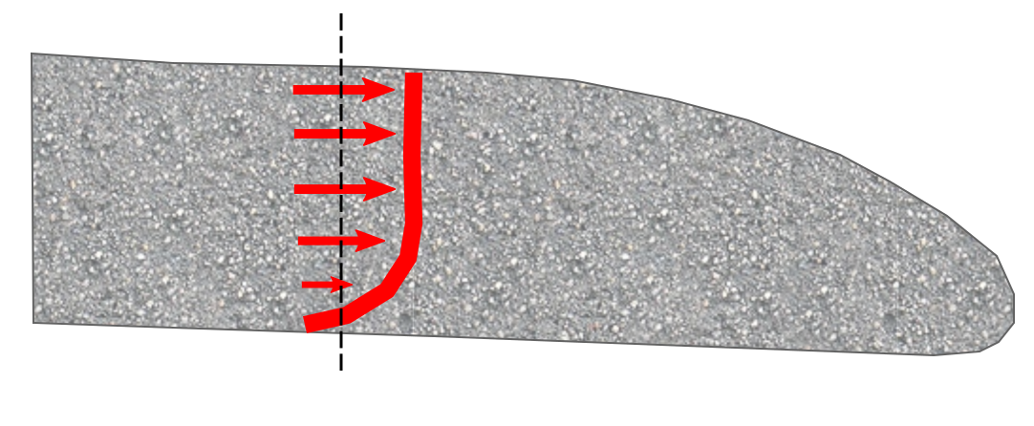
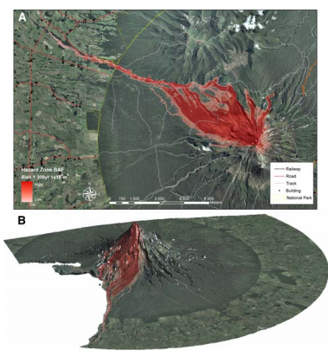
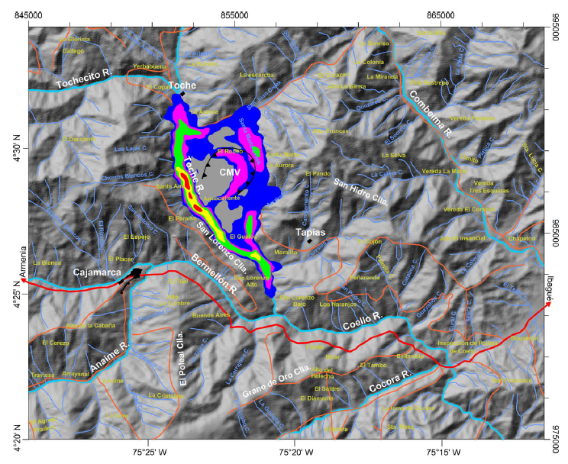
TITAN2D
TITAN2D is a computational model that simulates dry granular mass-flows over DEMs of natural terrain.
No ash-cloud surge!
Depth-averaged equations for the conservation of mass and momentum use Mohr-Coulomb friction terms.
Volume, basal and internal friction are model inputs
Comparisons of TITAN2D with both experimental and real pyroclastic flows have shown success in a wide variety of settings (Pitman et al. 2003; Patra et al. 2005; Rupp et al. 2006, etc.).
Depth averaged velocity
Cerro Machin, Columbia (Murcia et al. 2010)
Mt. Taranaki, NZ (Proctor et al. 2010)

Slide 26
TITAN2D is very sensitive to a number of input parameters:
Volume (volume of the total collapse)
Basal friction angle
Initial starting coordinates
Initial direction
Initial pile geometry
Because of this, it is extremely important to vary these parameters for different model runs.

Slide 27
Basal friction
∆H/L vs PDC Volume
The ∆H/L values for PDCs of different volumes work well for TITAN2D basal friction parameters
Convert ∆H/L values to degrees by:
Degrees(atan(∆H/L value))
More mobile
Best fit: ∆H/L = 0.10(Volume^{-0.15})

Slide 28
TITAN2D basal friction parameters from FlowDat regressions
Volume (km³) | Volume (10⁶ x m³) | Dome-collapse friction (deg) | Collumn-collapse friction (deg)
0.00001 | 0.01 | 28 (27-31) | 34 (27-42)
0.0001 | 0.1 | 21 (20-22) | 25 (21-29)
0.001 | 1 | 16 (15-16) | 23 (17-31)
0.01 | 10 | 12 (11-12) | 15 (12-19)
0.1 | 100 | 8 (7-9) | 10 (8-12)
Ranges in parentheses reflect the uncertainty
For TITAN2D runs, I usually use the lower end of the range!

Slide 29
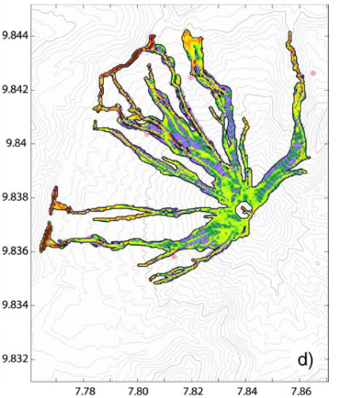
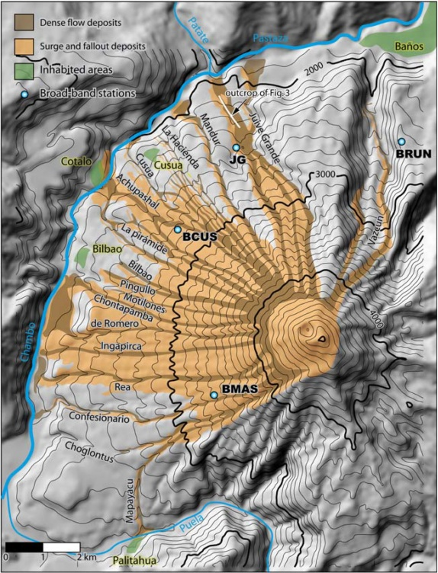
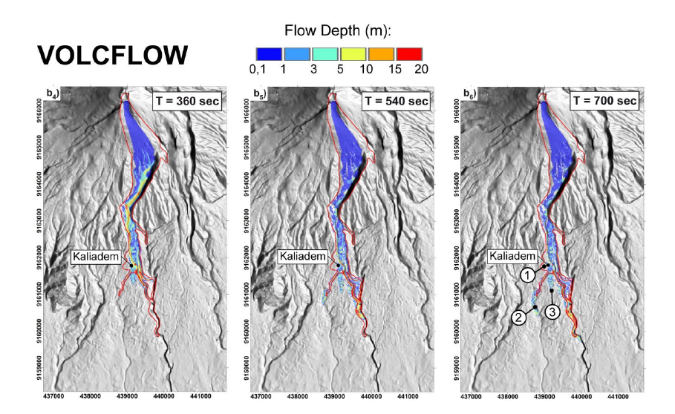
VolcFlow
VolcFlow solves depth-averaged equations of mass and momentum using a DEM.
No ash-cloud surge in basic version!
One stress parameter accounts for all retarding stresses
This stress parameter can be held constant for the constant retarding stress condition, so that the ratio of driving to retarding stress decreases as thickness increases
Takes volume, CRS, and bulk flow density
Volcflow has shown success in replicating pyroclastic flows at Tungurahua (Kelfoun 2009) and Merapi volcano (Charbonnier 2009).
Comparison of VolcFlow (left) and actual pyroclastic flow deposits (right) at Tungurahua Volcano, Ecuador. From (Kelfoun et al. 2009)
Comparison of VolcFlow and actual pyroclastic flow deposits (red) at Merapi Volcano, Indonesia. From (Charbonnier 2009)

Slide 30
All these models are averaging a number of variables that are actually highly unsteady and non-uniform in nature, especially in sustained, larger-volume flows with significant ash-cloud surge components.
Models cannot capture the effects of:
increasing excavation of pressurized dome material
interactions between subsequent flow pulses
evolving pore-fluid pressures and granular temperatures
variations in frictional vs. collisional regimes
sedimentation, erosion, or deposition
polydispersity of grain sizes, shapes, and densities
interplay between dense-basal undercurrent and ash-cloud surge
PDCs probably do not exhibit a fixed rheology, but evolve as fluid-pressure, grain concentration, and granular temperature change through time and space
These effects are probably most pronounced in large-volume PDCs, especially for column-collapse flows
Some multiphase models can model these things, but they are research tools, not hazard simulation tools because they take so long!

Slide 31
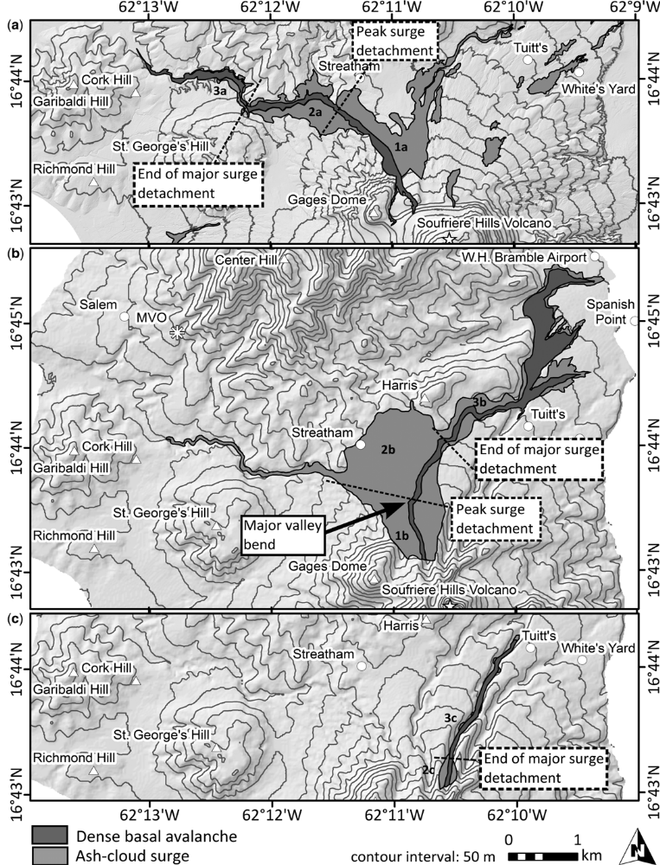
Ash-cloud surge
Can detach from the dense basal avalanche at constrictions in channels or valley bends and travel long distances over relatively flat ground
Decoupled surges often responsible for deaths (Soufrière Hills Volcano, Merapi, Unzen, Sinabung, Pelée)
Soufrière Hills Volcano, Montserrat
Ogburn et al. 2014

Slide 32
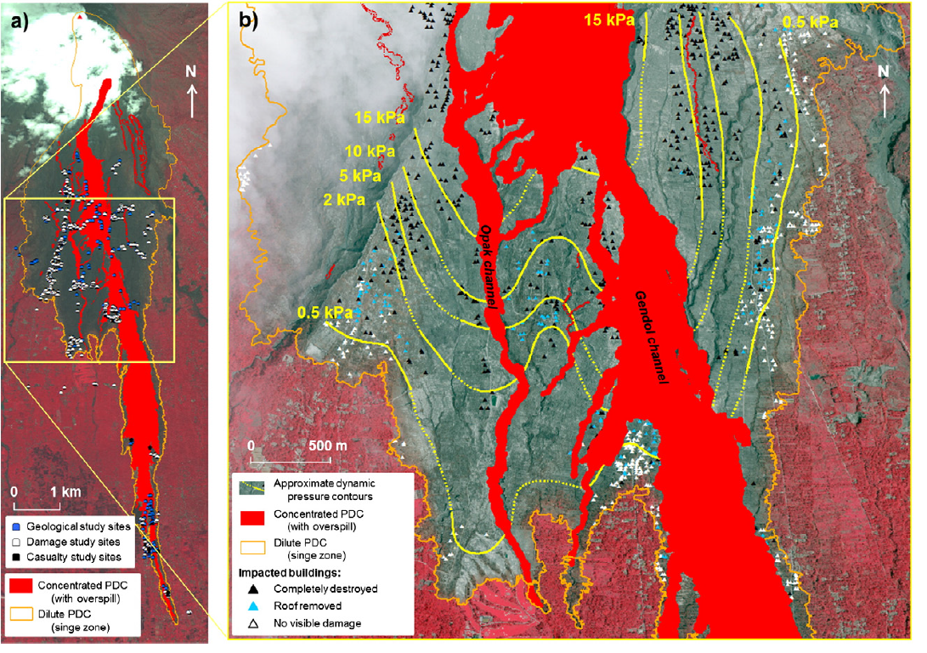
Merapi, Indonesia
Jenkins et al. 2013

Slide 33
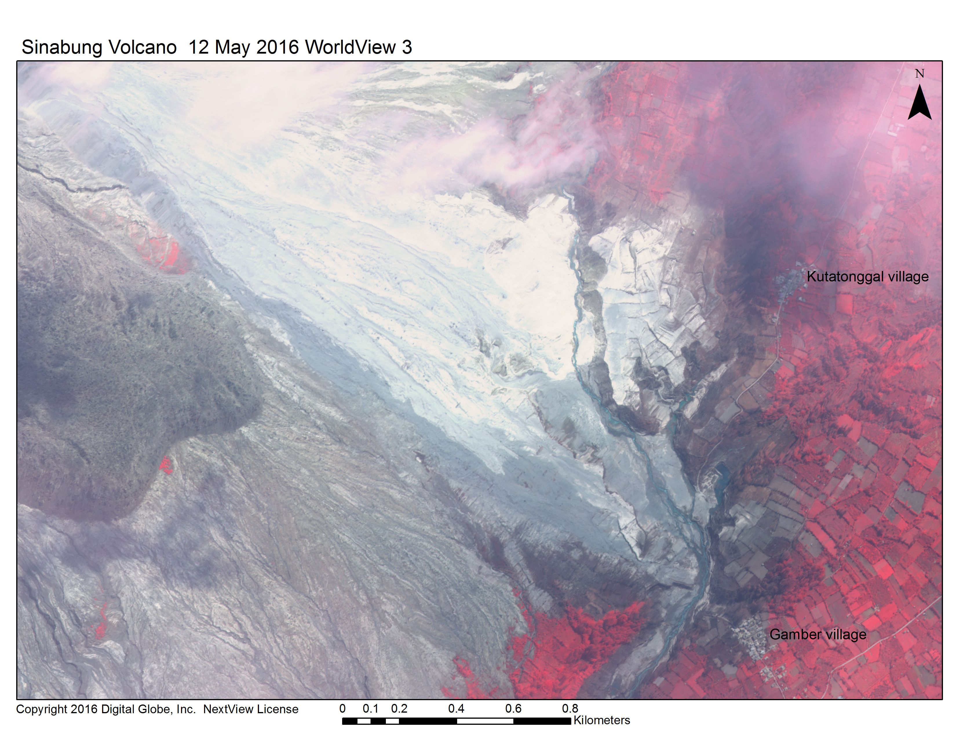

Slide 34
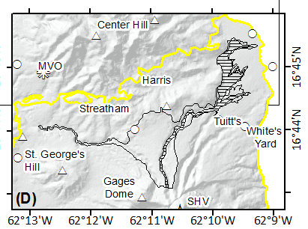
Ash-cloud surge
TITAN2D DOES NOT model the overriding, dilute, ash cloud surge component
∆H/L cones don’t explicitly model the surge, but they *may* encompass surge hazards because they don’t simulate a channelized flow

Slide 35
Model | Pros | Cons
Energy cone | With local ∆H/L vs. volume data, does a decent job reproducing flow runout Often captures ash-cloud surge hazard area too, because it’s not modeling channelization Extremely fast (< 1 minute) Very small output file sizes Very well-documented Only need to run Energy Cones for a range of volumes to produce a hazard map | Reliant on ∆H/L vs. volume data, if data is sparse for a particular volcano, relies on widely scattered global data which results in large spread in runout distances Might be overly-conservative because there’s no channelization Requires ArcGIS to run LAHARZ version
TITAN2D | Input parameters obtainable from deposits, observations Reasonable reproduction of inundation and velocity Reproduces gradually thinning and spreading margins of large volume deposits Small file size Can be run using only open-source software, either online at Vhub.org or on a linux machine Very well-documented | Requires accurate summit/dome DEM Sensitive to pile shape, geometry High velocities make things leave valleys when they shouldn’t No ash-cloud surge modeling Slow (4-8 hours) Requires many model runs to produce hazard map
VolcFlow | Reproduces inundation, thickness, and velocity very well Reproduces well-defined margins of small volume flows Faster than TITAN2D (1-2 hours) | CRS related to thickness, but poorly understood Doesn’t reproduce gradually thinning and spreading margins of large volume deposits very well No ash-cloud surge modeling Poorly documented Extremely large total file size (up to 100GB) Requires MATLAB, Surfer Requires many model runs to produce hazard map

Slide 36
Using models for hazard mapping
ONE MODEL RUN ≠ HAZARD MAP
For hazard mapping, the input parameters must be varied
For LAHARZ: use a variety of volumes down different valleys
For energy cone: use a variety of ∆H/L values to show hazard from different PDC volumes
For TITAN2D/VolcFlow/other physical models: use a variety of volumes, basal frictions angles, starting locations, and directions (fully probabilistic hazard maps require 1000’s of runs using a sampling of input parameter distributions)
Compare multiple models and consider geologic evidence of past flows
There’s lots of uncertainty in modeling PDCs, especially column-collapse flows!

Slide 37
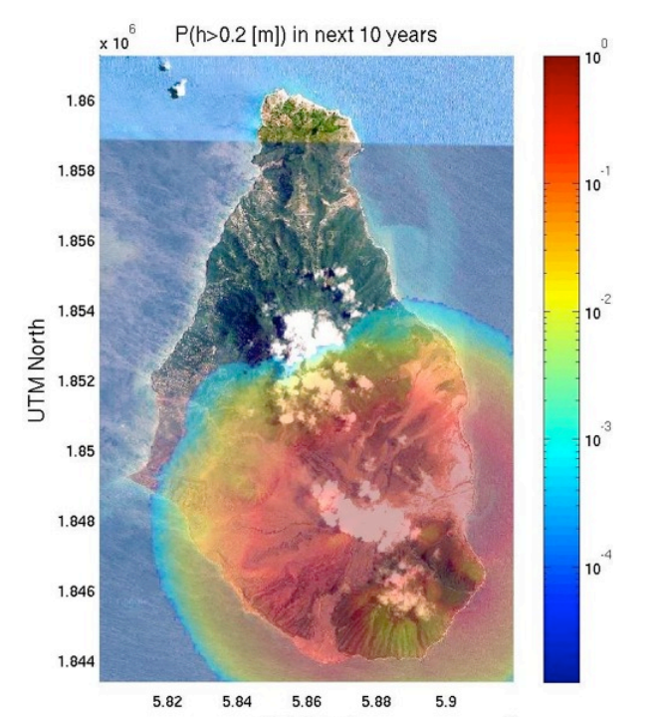
Energy Cone
TITAN2D
4 ∆H/L energy cones
(for 0.0001 to 0.1 km³)
< 5 minutes on 1 processer
100,000 TITAN2D model runs
(for 0.0001 to 0.1 km³)
~1000 hours on 1024 processers

Slide 38
Models are just one tool!
Geophysical models are just one tool to help you make a hazard map
The model outputs can be modified using your geological knowledge about the volcano and about the hazards, what is known about past events, and any other additional knowledge

Slide 39
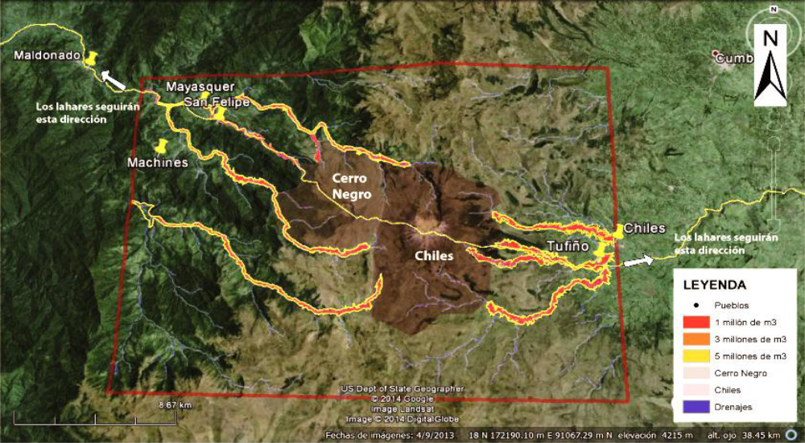
Software LaharZ. Casos de erupción del
Cerro Negro o Chiles.
P. Espin y F. Vasconez. IGEPN
Chiles-Cerro Negro, Colombia-Ecuador border

Slide 40
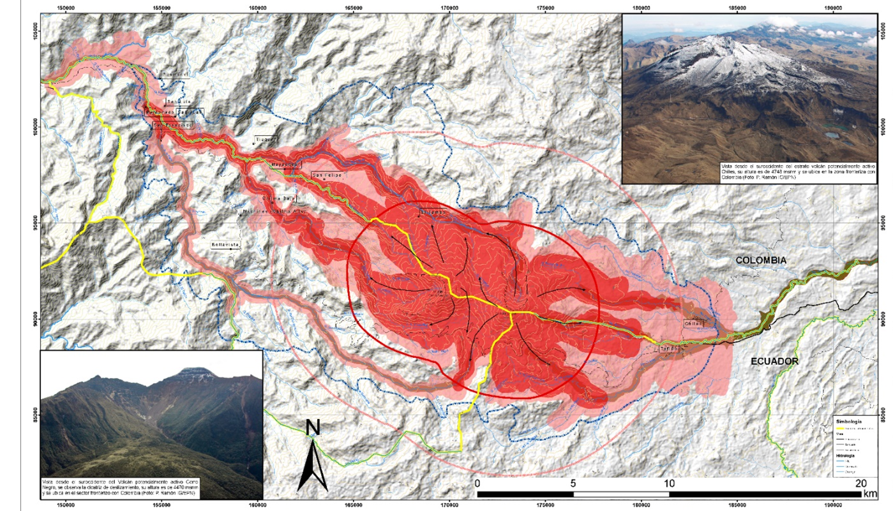
Chiles-Cerro Negro, Colombia-Ecuador border

Slide 41
Questions?

Slide 42
 | Energy Cone | TITAN2D/VolcFlow
DEM quality | DEM is old or poor resolution | DEM is new & good resolution
How much time do you have? | Limited time | Lots of time
What is your primary goal? | Hazard mapping | Understanding physics, answering a science question, exploring PDC behavior in particular valleys, or probabilistic hazard mapping (with lots of time for many runs)
Ash cloud surges | People live close to valleys, in interfluves, ash-cloud surge overbanking is a concern | You’re only concerned about runout and not ash-cloud surge spillage out of valleys
Expertise and resources | You’re a smart beginner with any computer | You’re an expert with lots of computing resources

Slide 43
How to use TITAN2D (or other geophysical models) when you can’t do thousands of model runs
Compare TITAN2D runs with similar ∆H/L cones for the same volumes
Use TITAN2D to see if only certain sectors will be affected (be sure to try different initial locations, directions, velocities to be sure)
Use TITAN2D to see if there are topographic barriers that the energy cone can’t ‘see’
Use TITAN2D to ask specific questions:
  How big of a flow would it take to reach point X
  What parameters would it take to make a flow go to the west

Slide 44
Model | Inputs | Rheological model | Assumptions | Solves | Outputs
Energy cone | DEM Starting point (can choose max elevation) ∆H/L (derived from volume and global stats) | Sliding block model, ∆H/L inversely proportional to V | Flows are well described by sliding block model, empirical relationship applies to all volcanoes | Draws an energy cone from user-supplied max elevation to elevation described by ∆H/L | Runout, as an energy cone
TITAN2D | DEM Volume Initial geometry and velocity Vol flux if running as a flux source Friction (basal and internal) | Mohr-Coulomb friction | Depth averaged | Equations of mass and momentum | Thickness Velocity Inundation area (can calculate KE)
VolcFlow | DEM Volume Initial geometry and velocity Constant retarding stress Density | Constant retarding stress | Depth averaged | Equations of mass and momentum | Thickness Velocity Inundation area (can calculate KE)

Slide 45
Column-collapse modeling
Difficult to know how much of the column will collapse vs. stay aloft/become ashfall
So there is a lot of uncertainty between VEI and column-collapse flow volume
Also, because the column-collapse flows spread out into all channels radially, it’s hard to know how much volume will go down each valley, and how far

